Slide 1

Schedule Builder
How to Devise an Ideal Spring Schedule
Presented by the Student Success Center

Slide 2

SeE YOUR Advisor
Each semester you need to meet with your advisor to approve your selected courses prior to being able to register.
Advised by faculty?
  Follow these tips to select and plan a schedule before your meeting

Slide 3
What is Schedule Builder?
A program that helps you build your ideal schedule based on desired classes and other activities such as work or extra-curriculars
Used in conjunction with the course schedule (courses.wvu.edu) and your Degree Works/major pattern sheet.

Slide 4
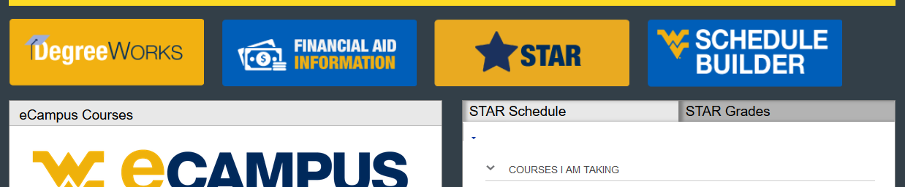
How do I find it?
Log in at portal.wvu.edu
Click on Schedule Builder

Slide 5
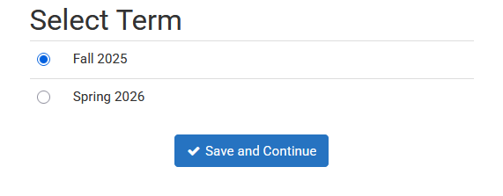
Select a term
Choose Fall 2025
Click Save

Slide 6
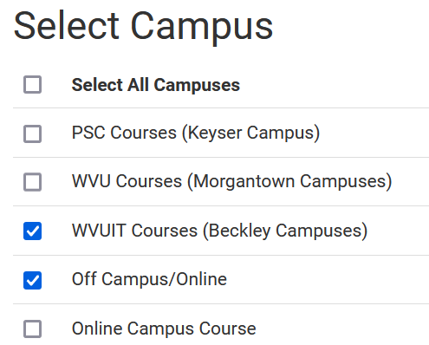
Select a campus (or two)
Always choose WVUIT Courses (Beckley Campuses)
If you want to take an online course, you need to also select Off Campus/Online
  Do not select Online Campus Course
Click Save and Continue

Slide 7
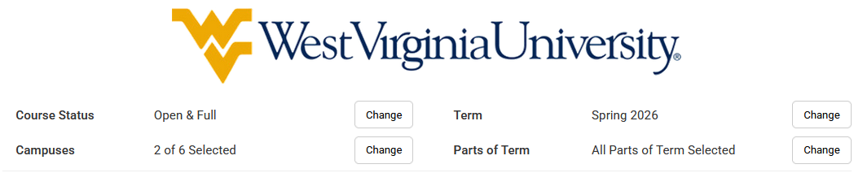
Set/change your defaults
Course Status options:
Open Classes Only (Default)
Open & Full
Open & Full w/Waitlist Open (Tech is not using Waitlists)

Slide 8
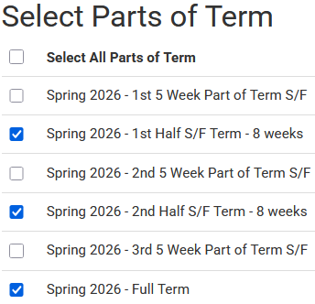
Set/change your defaults
Parts of term:
  See the whole semester and/or partial
  term courses

Slide 9
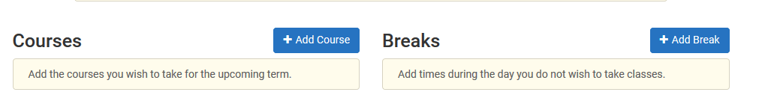
Add breaks
  Need to work around a practice or a meal?
  Click on Add Break

Slide 10
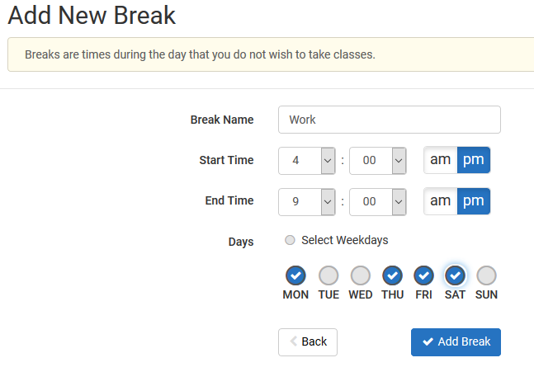
Add breaks
Add in work, meal, or practice times so classes that interfere won’t be shown.

Slide 11
Time to build!
Click on Add Course

Slide 12
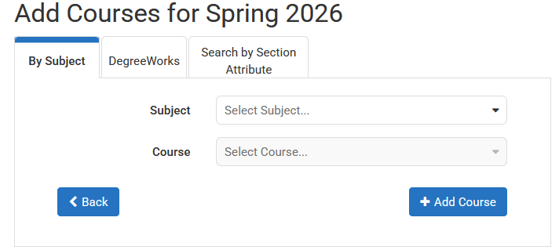
Time to build!
Begin typing the Subject of the course you want (Ex. ENGR) or use the dropdown and scroll to find it.

Slide 13
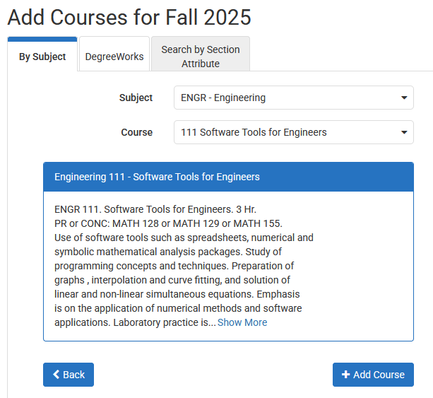
Check pre-reqs
Select the Course
  you are looking for.
Pre-requisite course information is in the description.
  PR = pre-requisite
  CONC = concurrent
Note: Sometimes WVU and Tech PRs are different.
Next, click Add Course

Slide 14
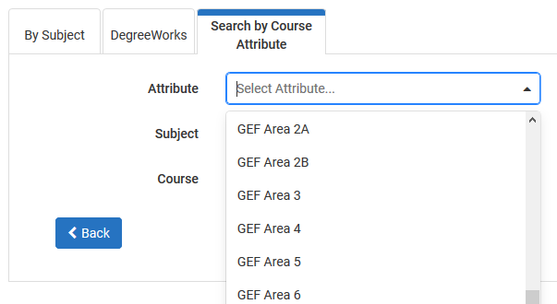
Search tips
In the Add Courses Menu, you can also choose to Search by Course Attribute.
This is helpful when
looking for GEF courses.
Be sure to not select GECs.

Slide 15
Caution!
Schedule Builder will allow you to add any course to your schedule, regardless if it is one you are eligible to register for.
  Be sure to check pre-requisite information and restrictions, as well as ensure it is a class offered by Tech.
  Tech course sections begin with a T!

Slide 16
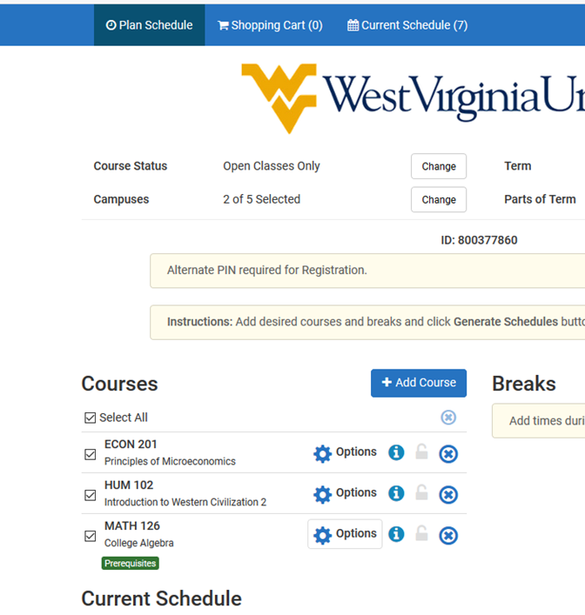
To Select tech courses…
If you selected the
Off Campus/Online campus option, you must de-select other campus’ courses.
Click Options

Slide 17
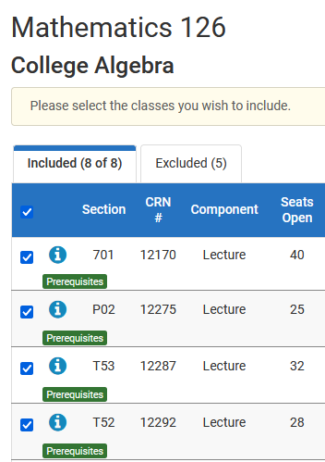
De-Select other courses
Un-check the box next to any courses with a section that begins with something other than a T.
Click Save & Close

Slide 18
classes offered by other wvu campuses
Tech students may take classes online through Potomac State (Keyser) or WVU Morgantown campuses.
    Cannot register for them through Schedule Builder.
    Must complete a Dual Campus Request form.
    There may be additional fees associated.
    Consult the schedule of courses to identify restrictions and requirements (ex: limited to certain majors, ranks, or different pre-requisites).

Slide 19
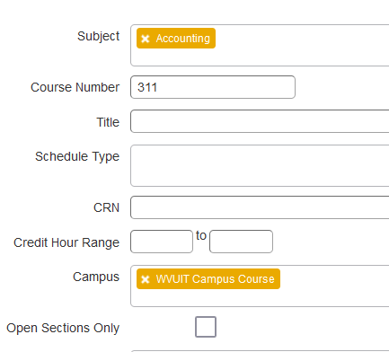
Check restrictions in the schedule of courses
Open a new tab
Go to Courses.wvu.edu
Find Spring 2026 in the drop down and select, click continue.
Many search options:
  Subject field
  Enter course number or 1% for just 100 level courses
  Pick a campus
Click Search or hit Enter

Slide 20
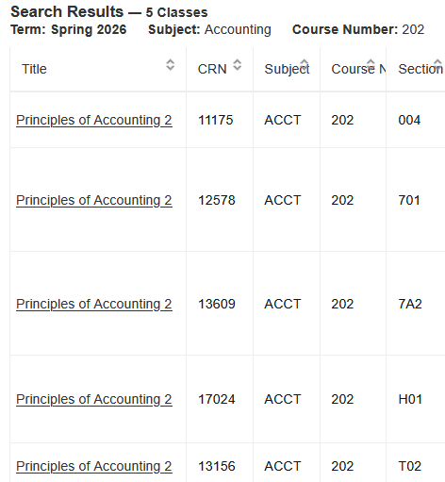
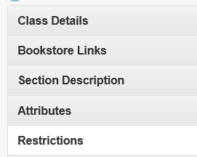
Check restrictions in schedule of courses
Click on the title of the course to view details
Click on the Restrictions Field

Slide 21
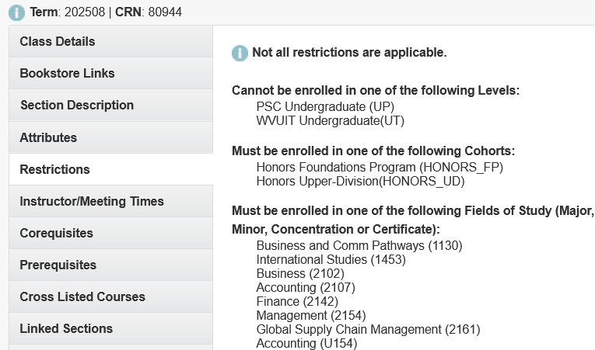
Check restrictions in schedule of courses
Level restriction:
Dual campus request is required
Field of Study restrictions:
Identifies major and/or minor
required

Slide 22

Back to Schedule Builder!

Slide 23
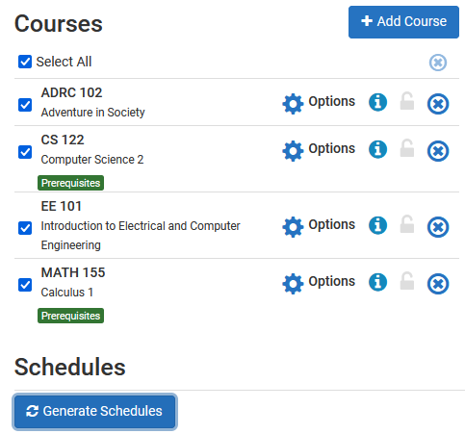
Generate schedules
Make sure Select All is checked in your list of Courses.
Click Generate Schedules.

Slide 24
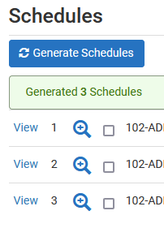
review schedules
Click View to see the schedule.
Note: Hovering above the magnifier only provides a preview.

Slide 25

review schedules
You can now scroll through the schedule options using your keyboard
arrow keys.
Or, at the top right, you can click on the arrow to see the next schedule.

Slide 26
Too many choices?
Click Back
Narrow results by clicking Options.

Slide 27
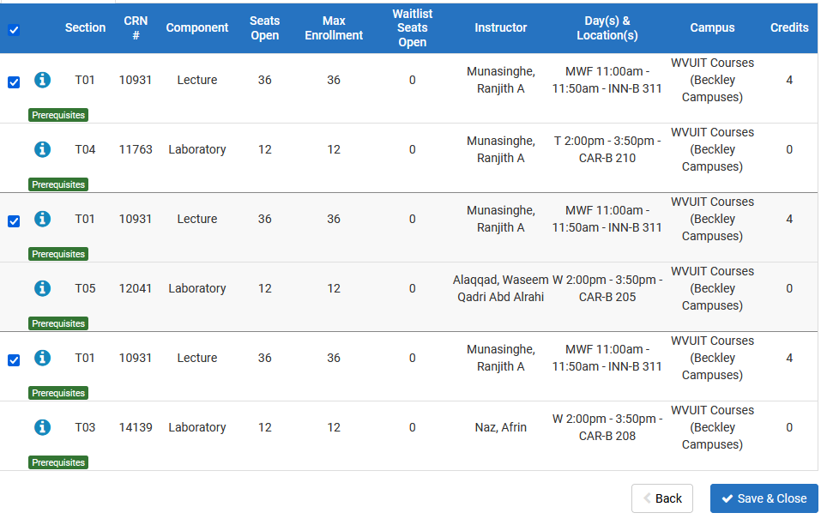
Narrow down your options
Un-check the box beside any course sections offered at times you are not interested in.
Click Save & Close to return to the previous page.
Click Generate Schedules.

Slide 28
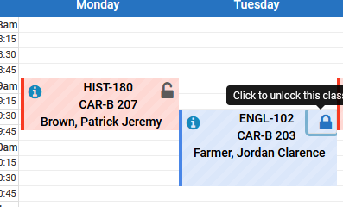
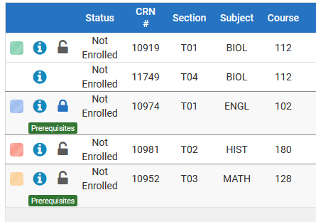

Still Too many choices?
When viewing a schedule, click the lock either in the top of the page or in the schedule itself to choose a section you prefer

Slide 29
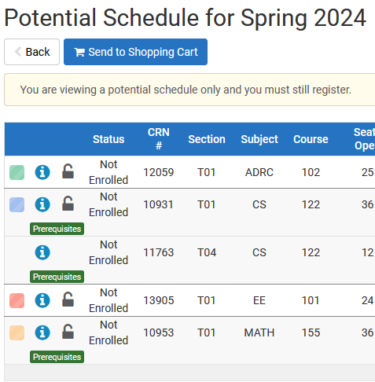
Send it to your cart
Once you have identified your preferred schedule, click
Send to Shopping Cart.

Slide 30
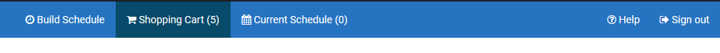
Want to make a change?
Click Build Schedule to go back and make changes.

Slide 31
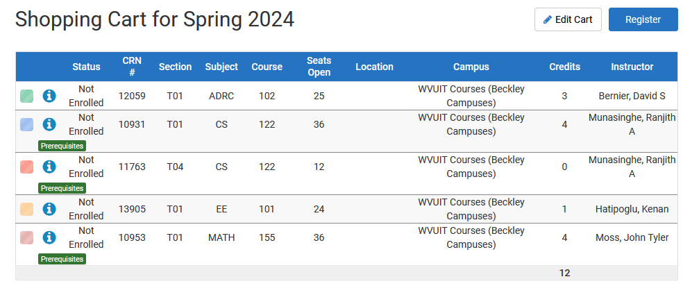
Almost done!
Once you’re satisfied with changes, click Register at the top of the screen.

Slide 32

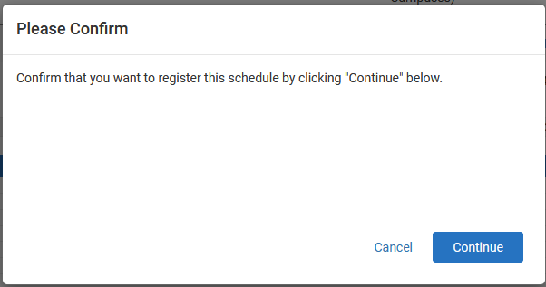
Last step

Slide 33
Error resolution
Common errors and resolutions are provided on the WVU Registrar’s site https://registrar.wvu.edu/registration/registration-errors-messages
Most common is a Level Restriction error.
  Check the Section number
      Tech sections begin with T
      PSC sections start with a P
      WVU sections start with a number
  Select a Tech section
  Or, if Tech doesn’t offer the course you need, go to the Registrar’s webpage. www.techregistrar.wvutech.edu
    Go to Forms
    Select the WVU System Visiting/Dual Campus form
    Click on the form and save it to your device
    Submit a Ticket for approval
If you can’t figure out why you’re getting the error, reach out to your advisor.

Slide 34
Stay Organized
Take a screen shot and update your pattern sheet.
Remember the schedule still may change.
Be sure to look up your schedule in STAR at the start of the spring semester and throughout Add/Drop week.

Slide 35
QUESTIONS?
  Thank you!

