Slide 1

Schedule Builder
Creating Your Ideal Schedule
Presented by the Student Success Center

Slide 2
What is Schedule Builder?
Program that helps you build your ideal schedule based on desired classes and other activities such as work or extra-curriculars.
Used in conjunction with the course schedule and your major pattern sheet.

Slide 3
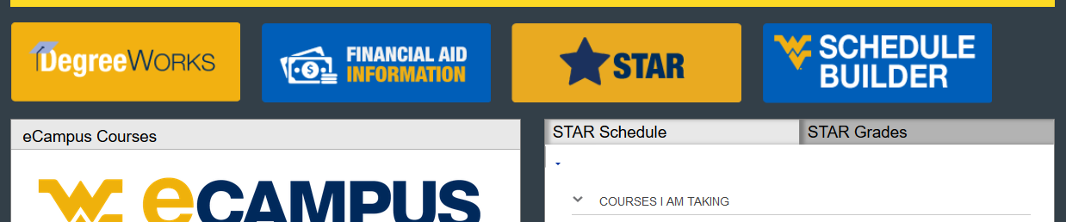
How do I find it?
Log in at portal.wvu.edu
Click on Schedule Builder

Slide 4
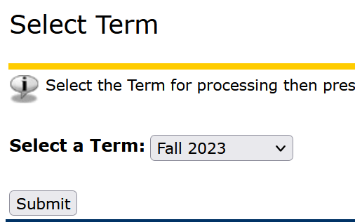
Select a term
Choose Fall 2023 and then
Click Submit

Slide 5
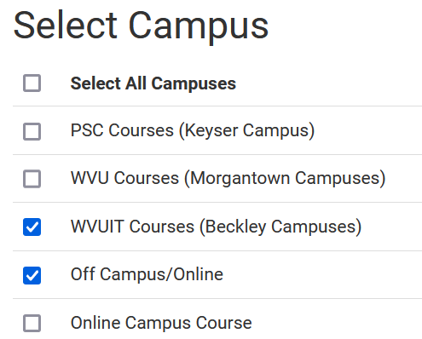
Select a campus (or two)
Always choose WVUIT Courses (Beckley Campuses)
And… if you want to take an online course, you need to also select Off Campus/Online
  Do not select Online Campus Course
Click Save and Continue

Slide 6
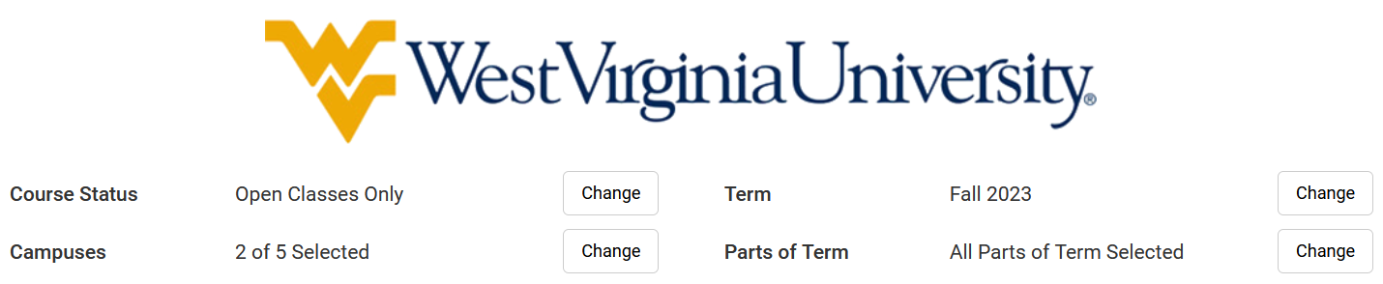
Set/change your defaults
Course Status options:
Open Classes Only (Default)
Open & Full
Open & Full w/Waitlist Open (Tech is not using Waitlists)

Slide 7
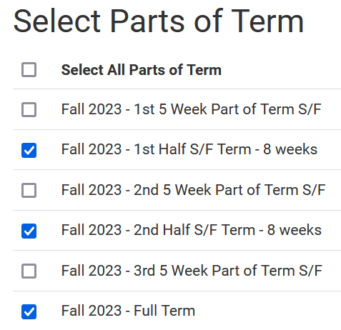
Set/change your defaults
Term:
  Can also schedule for Summer
  at this time
Parts of term:
  See the whole semester and/or partial
  term courses

Slide 8
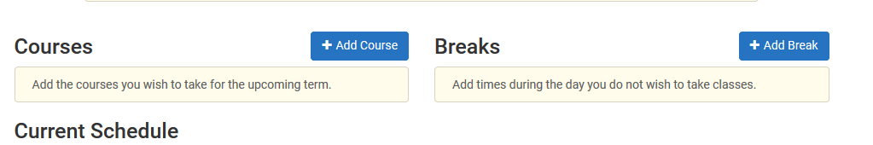
Add breaks
Need to work around a practice or a meal?
Click on Add Break

Slide 9
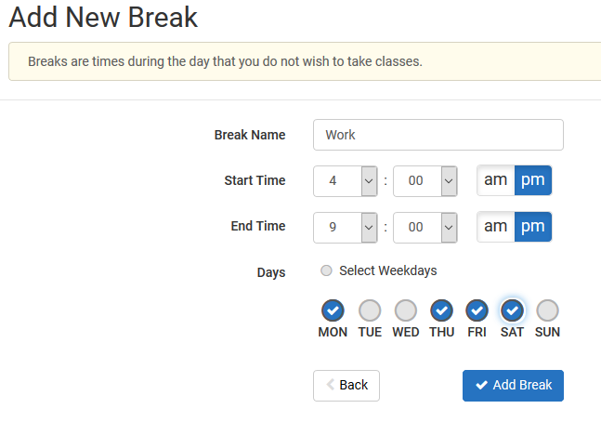
Add breaks
Add in work, meal, or practice times so classes that interfere won’t be shown.

Slide 10
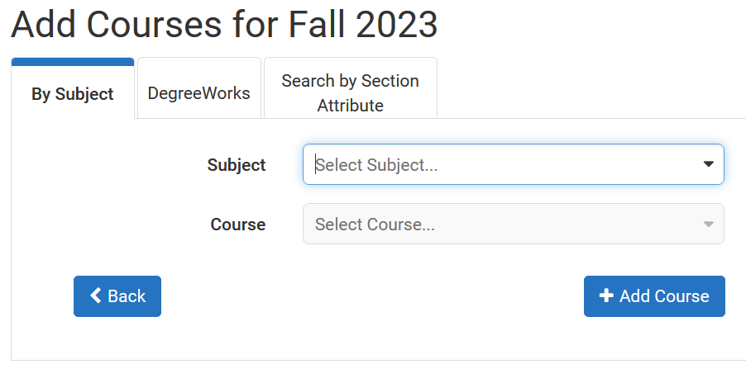
Time to add classes!
Click on Add Course
Begin typing the Subject of the course you want or use the dropdown to find it

Slide 11
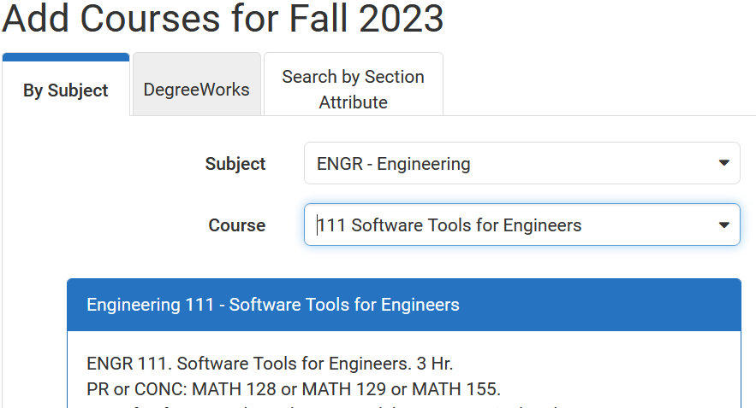
Adding Classes
Select the Course
  you are looking for.
Pre-requisite course information is in the description.
  PR = pre-requisite
  CONC = concurrent
Note: Sometimes WVU and Tech PRs are different.
Next, click Add Course

Slide 12
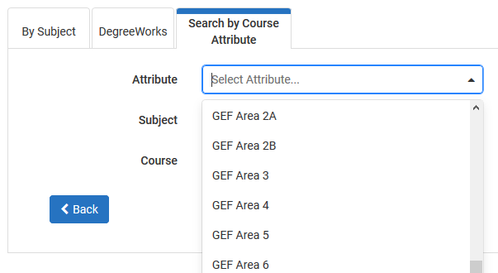
Adding Classes
In the Add Courses Menu, you can also choose to
Search by Course Attribute.
This is helpful when
looking for GEF courses
Be sure to not select GECs

Slide 13
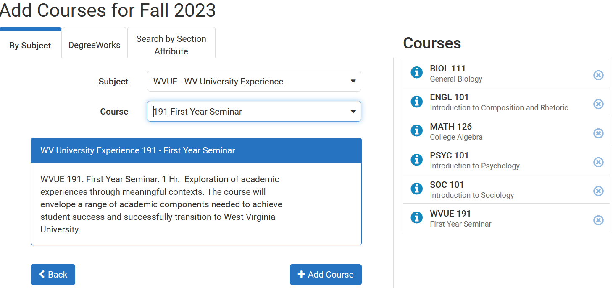
Adding Classes
Continue selecting courses and clicking Add Course until all of your desired courses appear on the Courses list on the right side of the page.
Click Back when all desired courses have been added.

Slide 14
Adding Classes
Caution!
Schedule Builder will allow you to add any course to your schedule, regardless if it is one you are eligible to register for.
  Be sure to check pre-requisite information and restrictions, as well as ensure it is a class offered by Tech.
  Tech course sections begin with a T!

Slide 15
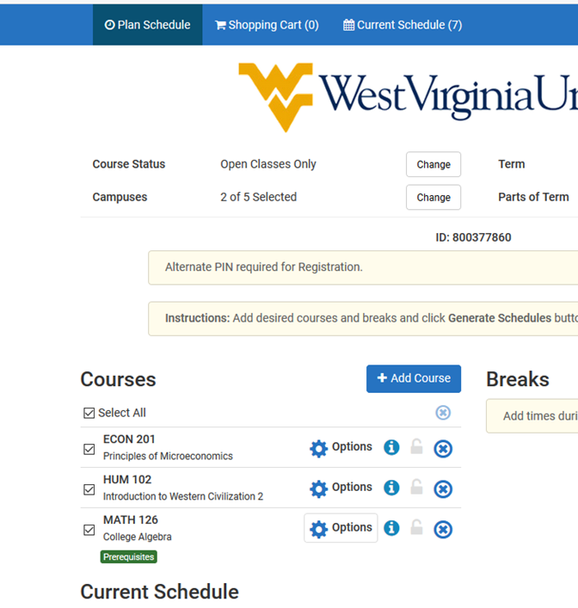
Adding Classes
If you selected the
Off Campus/Online campus option, you must be careful to go in and
de-select other campus’ courses.
Click Options

Slide 16
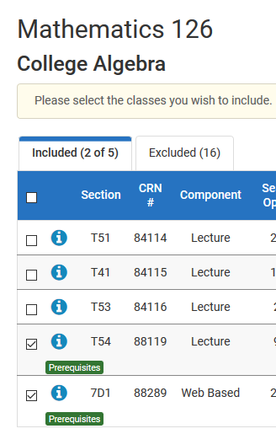
Adding Classes
Un-check the box next to any courses with a section that begins with something other than a T.
Then click Save & Close

Slide 17
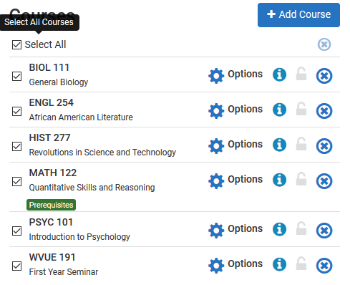
Generate schedules
Make sure Select All is checked in your list of Courses

Slide 18
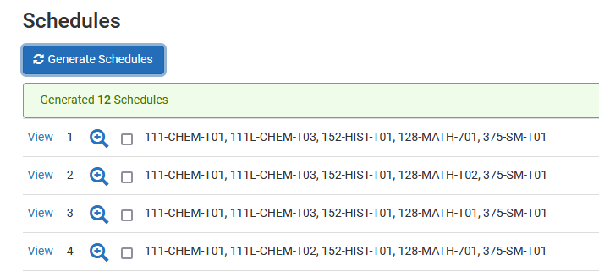
Generate schedules
Click Generate Schedules
Then click View to see the schedule.
Hovering above the magnifier only provides a preview.

Slide 19

review schedules
You can now scroll through the schedule options using your keyboard arrow keys.
Or, at the top right, you can click on the arrow to see the next schedule.

Slide 20
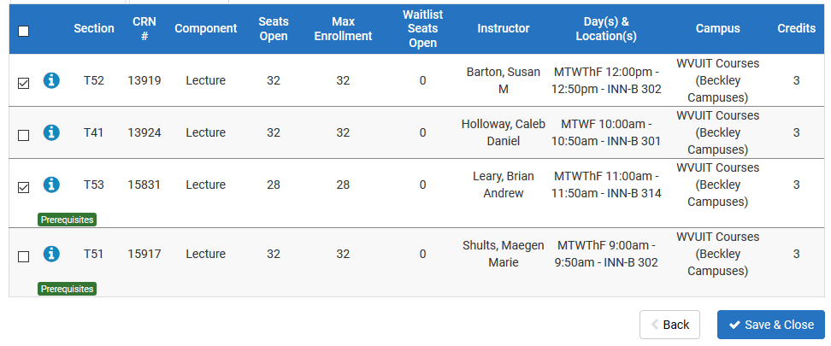
Narrow results
Then un-check any course sections offered at times you are not interested in.
Too many choices?
Click Options
Click Save & Close to return to the previous page and then once again click Generate Schedules.

Slide 21
Send it to your cart
Once you have identified your preferred schedule, click Send to Shopping Cart.

Slide 22
SeE YOUR Advisor
Good job!
You’re now ready for your advisor to approve your selected courses and provide your registration PIN.
If you are advised by the SSC, your advisor will provide your PIN and help you complete your registration during your meeting.

Slide 23
Completing registration
For Fall 2023:
Once you have your schedule in your cart, clicking Continue will take you to STAR.
In the drop-down, Select Fall 2023 for the Term.
Enter your registration PIN, which is provided by your advisor.
Click Continue
On the Register for Classes page, click the Plans tab at the top to access the schedule plan you sent over from Schedule Builder.

Slide 24
Completing registration
On the Plans page, you will see the courses you selected.
Click the Add button to the right of each row to add the courses to your schedule registration Summary list.
The Status of each course will display Pending.
After all courses are added to the Summary list, click the Submit button in the bottom right corner to register for the pending courses.
The status of each course will change to Registered and a success message will appear at the top of the window.

Slide 25
Error resolution
Schedule Builder follows all registration rules within STAR.
  Did you try to register for a restricted section?
  Do you meet the pre-requisites?
Check the Section to be sure you aren’t trying to register for a course from another campus.
  If it is a course from WVU or Potomac State, choose a Tech section
  Or, if Tech doesn’t offer what you need, go to the Registrar’s webpage www.techregistrar.wvutech.edu
    Go to Forms
    Select the WVU System Visiting/Dual Campus form
    Click on the form and save it to your device and then Submit a Ticket for approval
If you can’t figure out why you’re getting the error, reach out to your advisor.

Slide 26
QUESTIONS?
Please feel free to contact the Student Success Center advisors
Stop by the SSC
Email us
  Amanda Baker: Amanda.Baker2@mail.wvu.edu
  Carla Meredith: Carla.Meredith@mail.wvu.edu
  Thank you!

